Slide 1


DON’T BLOW YOUR TOPS WHY IT PAYS TO MAKE GOOD GRADES
Chelsey Hopkins
Comprehensive Advising Officer

Slide 2

MEDIA DISCLOSURE
By attending or participating in this presentation or event, you acknowledge that photography, video, and audio recording may occur. LOSFA reserves the right to use these materials for non-commercial, educational purposes, including but not limited to showcasing events on websites, social media, and other publications.
To protect privacy, names and other personal information will not be disclosed without prior written consent. By participating, you agree to release and hold harmless LOSFA from any claims related to the use of your likeness. If you do not wish to be recorded or photographed, please inform the event organizers or photographer.

Slide 3


ABOUT LOSFA
The Louisiana Office of Student Financial Assistance (LOSFA) is a Program of the Louisiana Board of Regents that strives to be Louisiana’s first choice for college access by promoting, preparing for and providing college access support to any student, any age, anywhere in Louisiana. LOSFA administers the state’s scholarship and grant programs and the state’s Internal Revenue Code Section 529 college savings program.

Slide 4

TOPS
Please remember that:
Funding for TOPS is contingent upon appropriations.
If TOPS is not fully funded, TOPS Awards and stipends will be determined on a pro-rata basis.
Students can opt out of receiving a TOPS Payment(s) if the program is not fully funded.

Slide 5

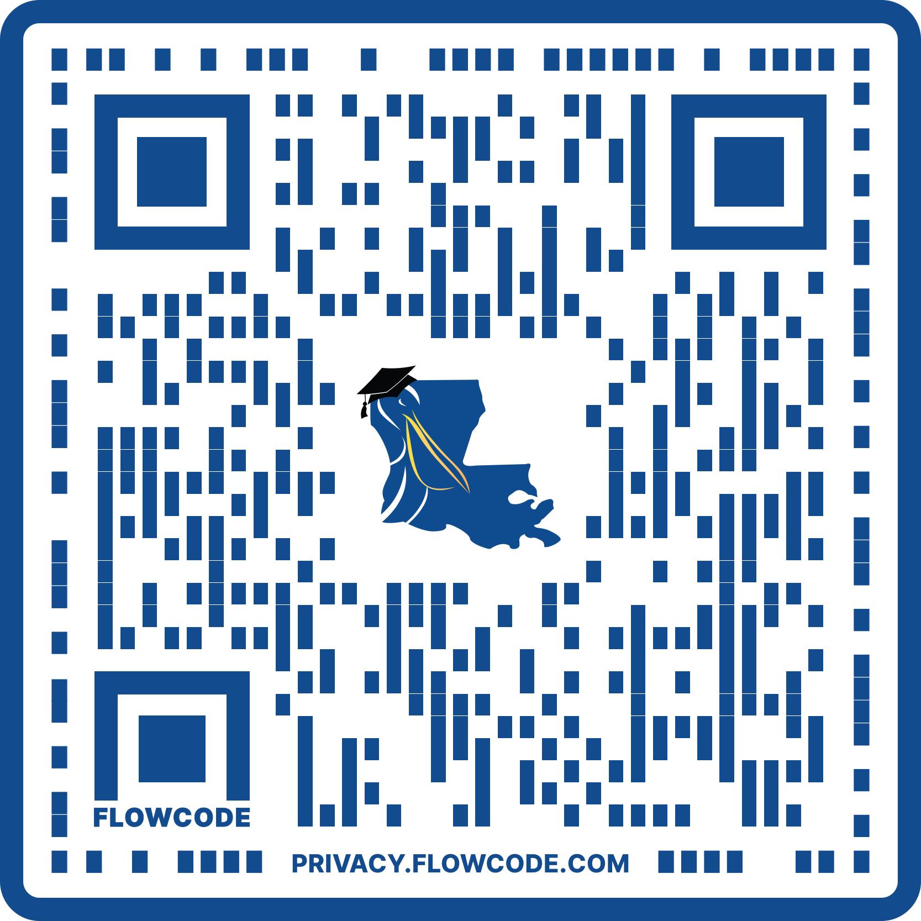
TOPS AWARD AMOUNT
TOPS Award Amounts are set at the maximum TOPS “fully funded” amount as the tuition charged by the institution for the 2016-2017 academic year.
This amount will not increase even if the institution raises tuition, unless the Louisiana Legislature enacts legislation to raise the TOPS Award Amounts.
See TOPS Award Amount chart: Scan QR code to access

Slide 6

CITIZENSHIP
A student must be a U.S. citizen, a permanent resident who is eligible to apply for citizenship, or a child of a non-citizen serving in the Armed Forces or honorably discharged from the Armed Forces.

Slide 7
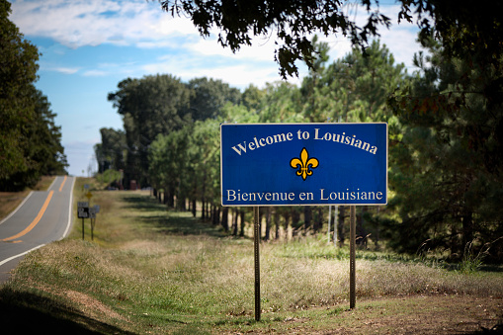
RESIDENCY
An independent student or a parent or court ordered custodian of a dependent student must have been a resident of the state of Louisiana and actually reside or live in Louisiana for the 24 months prior to high school graduation.
For 2026 graduates, residency must have been established no later than April 2024.

Slide 8

CRIMINAL CONVICTIONS
Have no criminal convictions
Excludes misdemeanor traffic violations
A student who has a “final criminal conviction” may not accept a TOPS award.
A juvenile conviction is generally not considered a final criminal conviction.
If the severity of the crime committed by a juvenile is such that he/she is tried as an adult, a subsequent conviction could be a “final criminal conviction.”
The student should contact his/her attorney to determine if their conviction is a final “criminal conviction.”

Slide 9

ACT
Highest composite score from a single test will be considered
TOPS does not consider the essay portion of the ACT in calculating the composite score needed to qualify
TOPS does not consider superscores
ACT Registration
TOPS Code 1595
Date of Birth

Slide 10

ACT
ACT Deadlines for 2026 Graduates
Without penalty: April 11, 2026
Loss of one semester eligibility: June 13, 2026 or July 11, 2026
Special tests may be taken prior to July 31st
A June or July ACT score can be used to upgrade TOPS Awards with a one semester or two quarter penalty
Students who fail to achieve a qualifying ACT score before August 1st of the graduating year shall not be considered for an award.
TOPS uses the highest composite score achieved and does not use superscoring.

Slide 11
CHANGES TO ACT TESTING
LOSFA is aware of ACT Inc.’s plan to make the Science portion of the ACT test optional, beginning with National online testing in spring 2025 and then for school-day testing in spring 2026.
According to Louisiana R.S. 17:5024, Section B, (1), a-d, states that the ACT score must be a composite score.
A student can take any of the ACT test options and use a composite score to qualify for TOPS.

Slide 12
SAT
An equivalent SAT score may be substituted for the ACT score
TOPS does not consider the essay portion of the SAT in calculating the composite score needed to qualify
SAT Registration
Scholarship Code 9019
SAT Test Deadlines
Without Penalty: March 14, 2026
Loss of 1-semester eligibility: May 2, 2026, and June 6, 2026

Slide 13
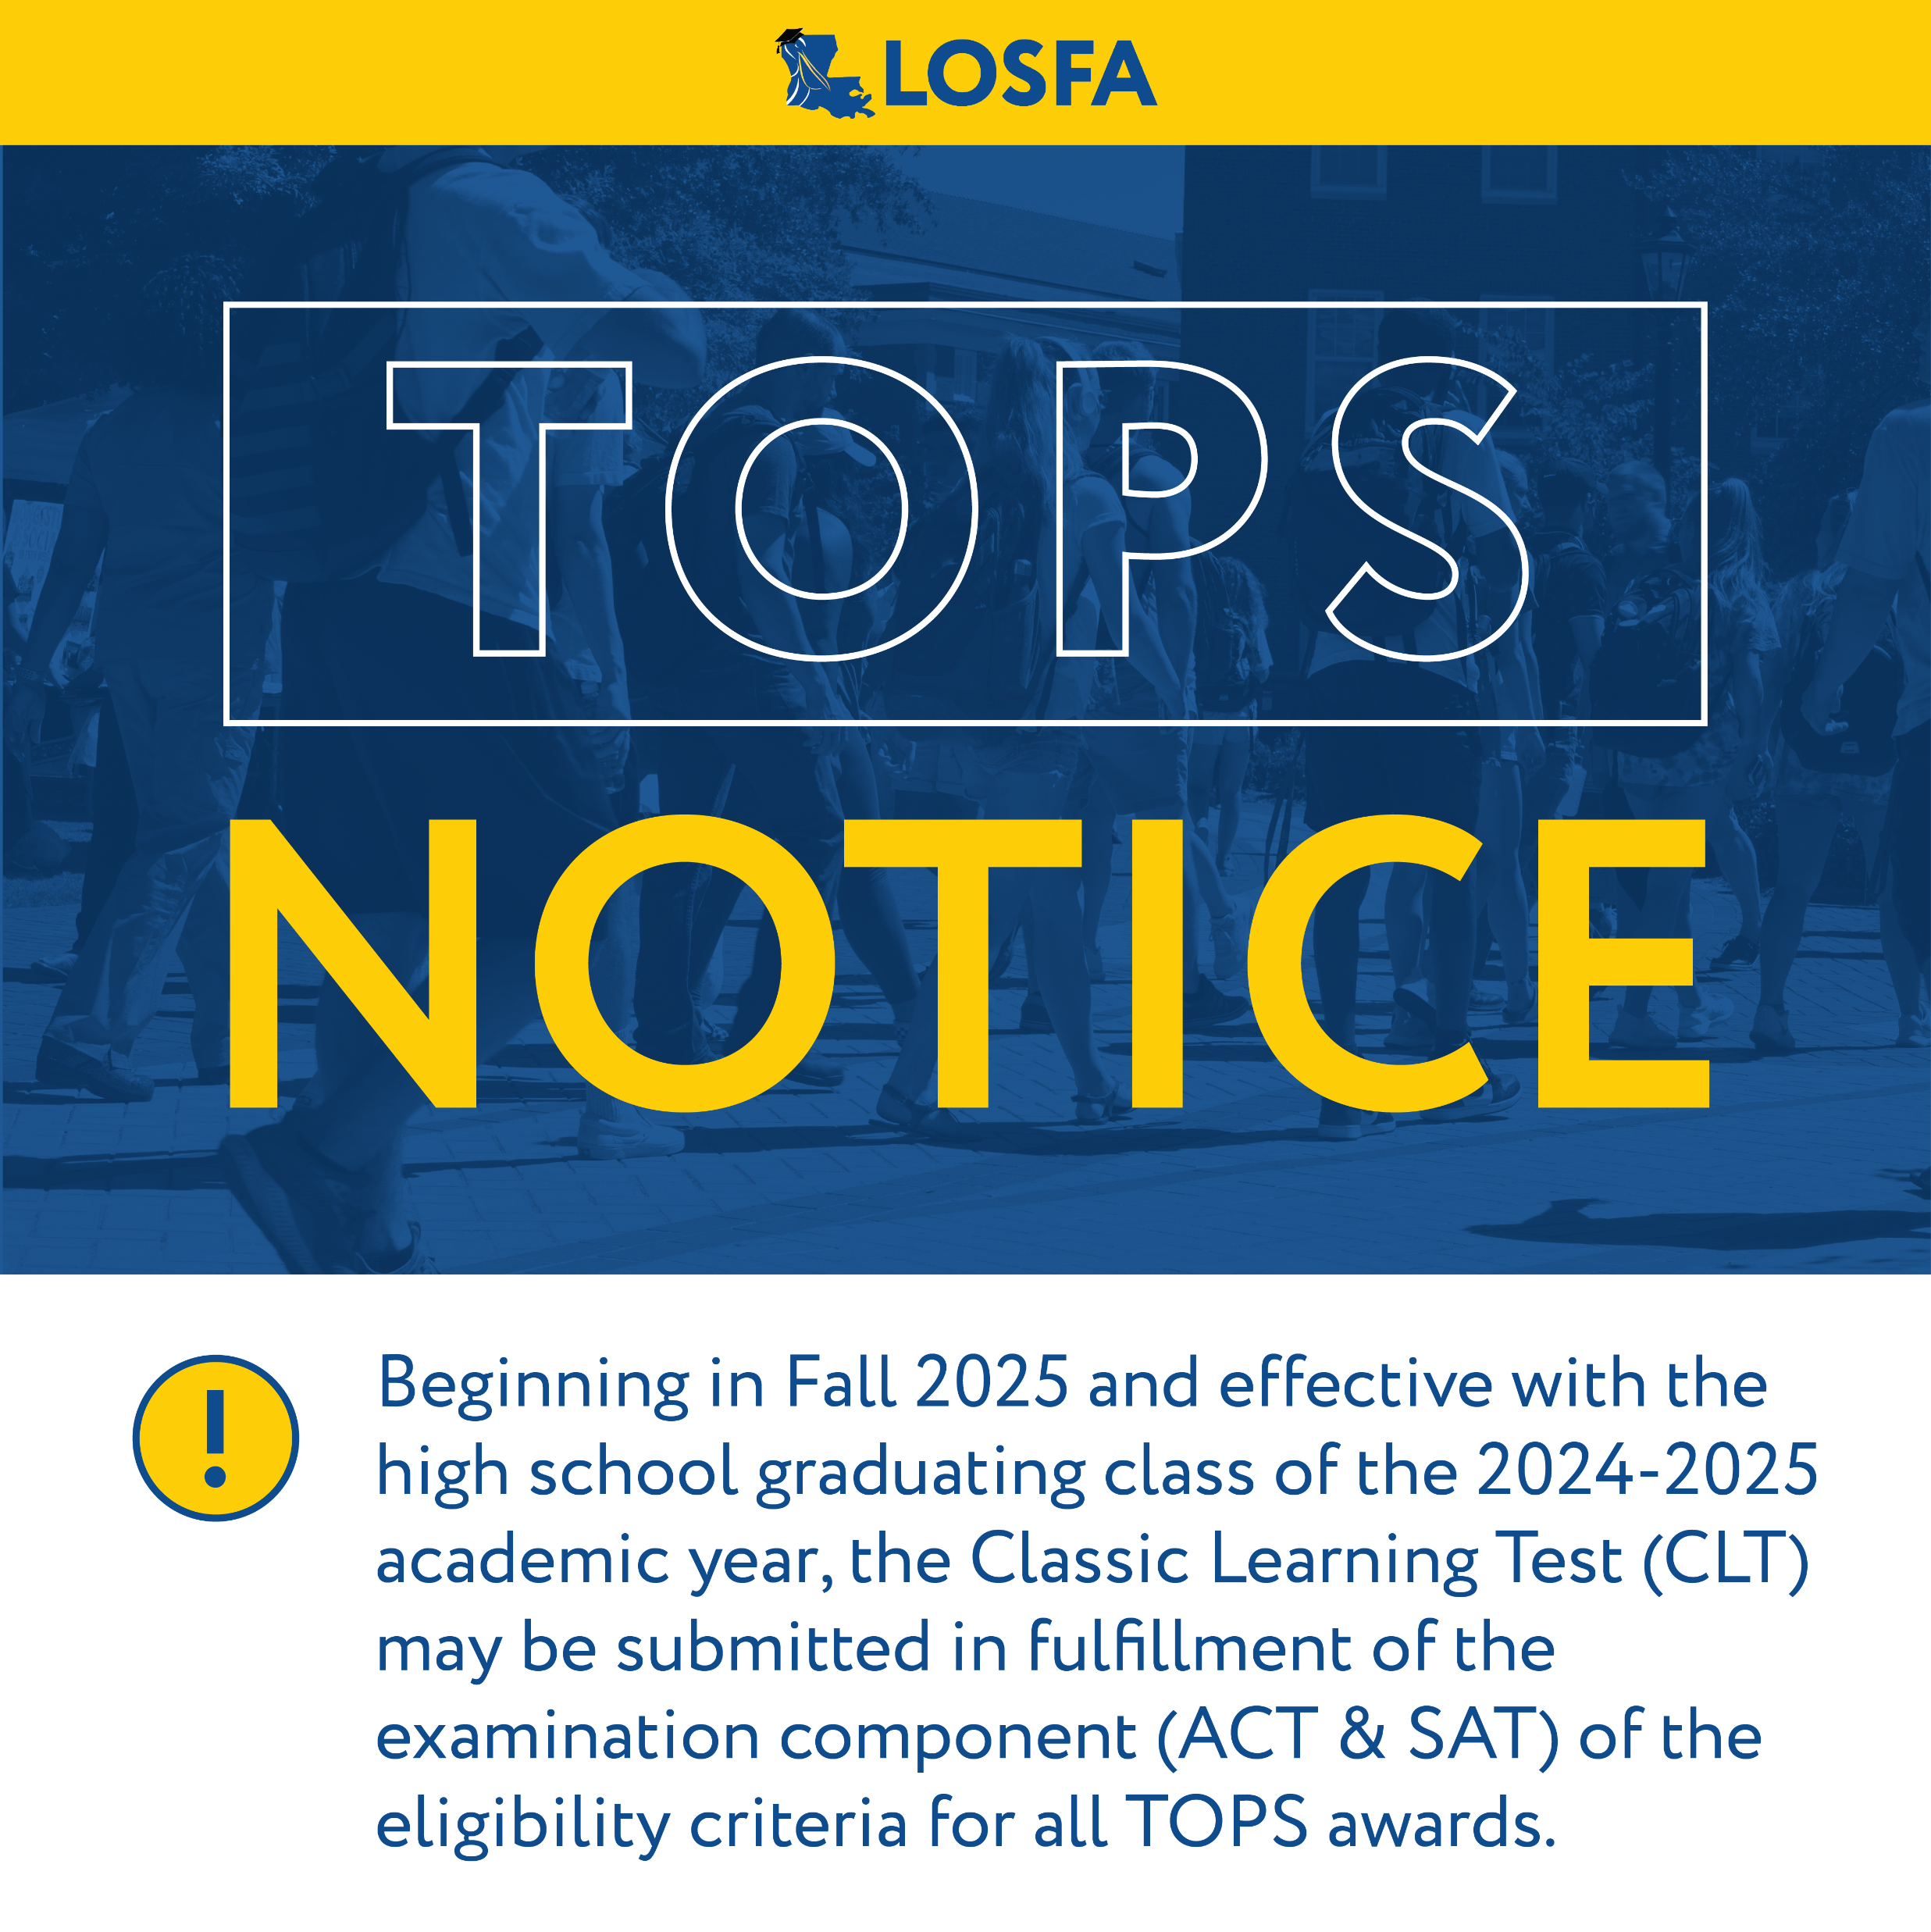
CLASSIC LEARNING TEST (CLT)
The Classic Learning Test (CLT) can now be used to qualify for TOPS.
Please note that eligibility requirements for a TOPS Award may differ from admission requirements at the institution you wish to attend.
Make sure you're familiar with admissions requirements by speaking to an admissions representative or visiting the institution's website.

Slide 14

TOPS AWARD LEVELS
OPPORTUNITY AWARD PERFORMANCE AWARD
HONORS AWARD
EXCELLENCE AWARD
TECH AWARD

Slide 15

TOPS CORE CURRICULUM
All TOPS core curriculum courses must be completed by the date of high school graduation
Distance learning courses approved by the high school may be used to qualify for TOPS
College courses taken in the classroom, online, or by correspondence may be used to qualify for TOPS provided that they are determined to be equivalent courses and appear on the student’s official high school transcript

Slide 16
TOPS CORE CURRICULUM
The TOPS core curriculum is for each year from the graduating class of 2026 through the graduating class of 2029.
Different requirements are applicable to each of these graduating classes.
Please check the LOSFA website at mylosfa.la.gov for detailed information on the core curriculum required for each graduating class.

Slide 17


CORE CURRICULUM
TOPS OPPORTUNITY, PERFORMANCE, HONORS, AND EXCELLENCE FOR GRADUATES OF 2018-2026

Slide 18
,
TOPS OPPORTUNITY, PERFORMANCE, HONORS, AND EXCELLENCE CORE CURRICULUM
Beginning with the Graduating Class of 2018 - 2026
ENGLISH = 4 UNITS | COURSES
1 Unit | English I
1 Unit | English II
1 Unit from the following: | English III, AP English Language Arts and Composition, or IB English III (Language A or Literature and Performance)
1 Unit from the following: | English IV, AP English Literature and Composition, or IB English IV (Language A or Literature and Performance)

Slide 19
TOPS OPPORTUNITY, PERFORMANCE, HONORS, AND EXCELLENCE CORE CURRICULUM
Beginning with the Graduating Class of 2018 - 2026
MATH = 4 UNITS | COURSES
1 Unit | Algebra I
1 Unit | Geometry
1 Unit | Algebra II
 | (Integrated Mathematics I, Integrated Mathematics II, and Integrated Mathematics III may be substituted for the Algebra I, Geometry, and Algebra II sequence)
1 Unit from the following: | Algebra III; Advanced Math - Functions and Statistics, Advanced Math - Pre-Calculus, Pre-Calculus, or IB Math Methods I (Mathematical Studies SL); Calculus, AP Calculus AB, or IB Math Methods II (Mathematics SL); AP Calculus BC; Probability and Statistics or Statistical Reasoning or AP Statistics; IB Further Mathematics HL; IB Mathematics HL; AP Computer Science A

Slide 20
TOPS OPPORTUNITY, PERFORMANCE, HONORS, AND EXCELLENCE CORE CURRICULUM
Beginning with the Graduating Class of 2018 - 2026
SCIENCE = 4 UNITS | COURSES
1 Unit | Biology I
1 Unit | Chemistry I
2 Units from the following: | Earth Science; Environmental Science or Environmental Awareness; Physical Science or Principles of Engineering; Agriscience I and Agriscience II (one unit combined); Chemistry II or AP Chemistry or IB Chemistry II; AP Environmental Science or IB Environmental Systems; Physics I, AP Physics I, AP Physics B, or IB Physics I; AP Physics C: Electricity and Magnetism, AP Physics C: Mechanics, or IB Physics II, or AP Physics II; Biology II or AP Biology or IB Biology II or Human Anatomy and Physiology

Slide 21
TOPS OPPORTUNITY, PERFORMANCE, HONORS, AND EXCELLENCE CORE CURRICULUM
Beginning with the Graduating Class of 2018 - 2026
SOCIAL STUDIES = 4 UNITS | COURSES
1 Unit from the following: | U.S. History, AP U.S. History, or IB U.S. History
1 Unit from the following: | Civics, Government, AP U.S. Government and Politics: Comparative, or AP U.S. Government and Politics: United States
2 Units from the following: | Western Civilization, European History, or AP European History; World Geography or Physical Geography, AP Human Geography, or IB Geography; World History, AP World History, or IB World History; History of Religion; IB Economics, Economics, AP Macroeconomics, or AP Microeconomics; AP Psychology; African American History; Introduction to Psychology

Slide 22
TOPS OPPORTUNITY, PERFORMANCE, HONORS, AND EXCELLENCE CORE CURRICULUM
Beginning with the Graduating Class of 2018 - 2026
FOREIGN LANGUAGE = 2 UNITS | COURSES
 | Foreign Language, both units in the same language, which may include the following: AP Chinese Language and Culture, AP French Language and Culture, AP German Language and Culture, AP Italian Language and Culture, AP Japanese Language and Culture, AP Latin, AP Spanish Language and Culture, IB French IV, IB French V, IB Spanish IV, and IB Spanish V; Mandarin Chinese I, II, III, IV Hindi I, II, III, IV Portuguese I, II, III, IV Vietnamese I, II, III, IV

Slide 23
TOPS OPPORTUNITY, PERFORMANCE, HONORS, AND EXCELLENCE CORE CURRICULUM
Beginning with the Graduating Class of 2018 - 2026
ART = 1 UNIT | COURSES
1 Unit from the following: | Performance course in Music, Dance or Theatre; Fine Arts Survey; Art I, II, III, and IV; Talented Art I, II, III, and IV; Talented Music I, II, III and IV; Talented Theater Arts I, II, III, and IV; Speech III and Speech IV (one unit combined); AP Art History; AP Studio Art: 2-D Design; AP Studio Art: 3-D Design; AP Studio Art: Drawing; AP Music Theory; IB Film Study I; IB Film Study II; IB Music I; IB Music II; IB Art Design III; IB Art Design IV; IB Theatre I or Drafting; Digital Image and Motion Graphics; Digital Storytelling; Engineering Design and Development; Sound Design

Slide 24
CORE CURRICULUM
TOPS TECH FOR GRADUATES OF 2018-2026

Slide 25
TOPS TECH CORE CURRICULUM
Beginning with the Graduating Class of 2018 - 2026
UNITS | COURSES
1 | English I
1 | English II
2 | English III, English IV, AP or IB English courses, Business English, Technical Writing, or comparable Louisiana Technical College courses offered by Jump Start regional teams as approved by the State Board of Elementary and Secondary Education.

Slide 26
TOPS TECH CORE CURRICULUM
Beginning with the Graduating Class of 2018 - 2026
UNITS | COURSES
1 | Algebra I; or both Algebra I, Part 1 and Algebra I, Part 2; or an applied or hybrid algebra course
3 | Geometry, Algebra II, Math Essentials, Financial Literacy, Business Math, Algebra III, Advanced Math -Functions and Statistics, Advanced Math - Pre-Calculus, Pre-calculus, or comparable Louisiana Technical College courses offered by Jump Start regional teams as approved by the State Board of Elementary and Secondary Education. Integrated Mathematics I, II, and III may be substituted for Algebra I, Geometry, and Algebra II, and shall equal three mathematics credits

Slide 27
TOPS TECH CORE CURRICULUM
Beginning with the Graduating Class of 2018 - 2026
UNITS | COURSES
1 | Biology
1 | Chemistry I, Earth Science, Environmental Science, Agriscience I and Agriscience II (both for one unit), Physical Science, or AP or IB science courses
1 | U.S. History, AP U.S. History, or IB U.S. History
1 | Civics, Government, AP U.S. Government and Politics: Comparative, or AP U.S. Government and Politics: United States

Slide 28
TOPS TECH CORE CURRICULUM
Beginning with the Graduating Class of 2018 - 2026
UNITS | COURSES
9 | In Jump Start course sequences, workplace experiences, and credentials. A student shall complete a regionally designed series of Career and Technical Education Jump Start coursework and workplace-based learning experiences leading to a statewide or regional Jump Start credential. This shall include courses and workplace experiences specific to the credential, courses related to foundational career skills requirements in Jump Start, and other courses, including career electives, that the Jump Start regional team determines are appropriate for the career major.

Slide 29
CORE CURRICULUM
TOPS OPPORTUNITY, PERFORMANCE, HONORS, AND EXCELLENCE FOR GRADUATES OF 2027

Slide 30
TOPS OPPORTUNITY, PERFORMANCE, HONORS, AND EXCELLENCE CORE CURRICULUM
For the Graduating Class of 2027
ENGLISH = 4 UNITS | COURSES
1 Unit | English I
1 Unit | English II
1 Unit from the following: | English III, AP English Language Arts and Composition, or IB English III (Language A or Literature and Performance)
1 Unit from the following: | English IV, AP English Literature and Composition, or IB English IV (Language A or Literature and Performance)

Slide 31
TOPS OPPORTUNITY, PERFORMANCE, HONORS, AND EXCELLENCE CORE CURRICULUM
For the Graduating Class of 2027
MATH = 4 UNITS | COURSES
1 Unit | Algebra I
1 Unit | Geometry
1 Unit | Algebra II
 | (Integrated Mathematics I, Integrated Mathematics II, and Integrated Mathematics III may be substituted for the Algebra I, Geometry, and Algebra II sequence)
1 Unit from the following: | Algebra III; Advanced Math - Functions and Statistics, Advanced Math - Pre-Calculus, Pre-Calculus, or IB Math Methods I (Mathematical Studies SL); Calculus, AP Calculus AB, or IB Math Methods II (Mathematics SL); AP Calculus BC; Probability and Statistics or Statistical Reasoning or AP Statistics; IB Further Mathematics HL; IB Mathematics HL; AP Computer Science A

Slide 32
TOPS OPPORTUNITY, PERFORMANCE, HONORS, AND EXCELLENCE CORE CURRICULUM
For the Graduating Class of 2027
SCIENCE = 4 UNITS | COURSES
1 Unit | Biology I
1 Unit | Chemistry I
2 Units from the following: | Earth Science; Environmental Science or Environmental Awareness; Physical Science or Principles of Engineering; Agriscience I and Agriscience II (one unit combined); Chemistry II or AP Chemistry or IB Chemistry II; AP Environmental Science or IB Environmental Systems; Physics I, AP Physics I, AP Physics B, or IB Physics I; AP Physics C: Electricity and Magnetism, AP Physics C: Mechanics, or IB Physics II, or AP Physics II; Biology II or AP Biology or IB Biology II or Human Anatomy and Physiology

Slide 33
TOPS OPPORTUNITY, PERFORMANCE, HONORS, AND EXCELLENCE CORE CURRICULUM
For the Graduating Class of 2027
SOCIAL STUDIES = 4 UNITS | COURSES
1 Unit from the following: | U.S. History, AP U.S. History, or IB U.S. History
1 Unit from the following: | Civics, Government, AP U.S. Government and Politics: Comparative, or AP U.S. Government and Politics: United States
2 Units from the following: | Western Civilization, European History, or AP European History; World Geography or Physical Geography, AP Human Geography, or IB Geography; World History, AP World History, or IB World History; History of Religion; IB Economics, Economics, AP Macroeconomics, or AP Microeconomics; AP Psychology; African American History; Introduction to Psychology

Slide 34
TOPS OPPORTUNITY, PERFORMANCE, HONORS, AND EXCELLENCE CORE CURRICULUM
For the Graduating Class of 2027
 | COURSES
FOREIGN LANGUAGE = 2 UNITS | Foreign Language, both units in the same language, which may include the following: AP Chinese Language and Culture, AP French Language and Culture, AP German Language and Culture, AP Italian Language and Culture, AP Japanese Language and Culture, AP Latin, AP Spanish Language and Culture, IB French IV, IB French V, IB Spanish IV, and IB Spanish V; Mandarin Chinese I, II, III, IV Hindi I, II, III, IV Portuguese I, II, III, IV Vietnamese I, II, III, IV
OR
COMPUTER SCIENCE = 2 UNITS | Computer Science, AP Computer Science A, Computer Coding as a Foreign Language I, Computer Coding as a Foreign Language II

Slide 35
TOPS OPPORTUNITY, PERFORMANCE, HONORS, AND EXCELLENCE CORE CURRICULUM
For the Graduating Class of 2027
ART = 1 UNIT | COURSES
1 Unit from the following: | Performance course in Music, Dance or Theatre; Fine Arts Survey; Art I, II, III, and IV; Talented Art I, II, III, and IV; Talented Music I, II, III and IV; Talented Theater Arts I, II, III, and IV; Speech III and Speech IV (one unit combined); AP Art History; AP Studio Art: 2-D Design; AP Studio Art: 3-D Design; AP Studio Art: Drawing; AP Music Theory; IB Film Study I; IB Film Study II; IB Music I; IB Music II; IB Art Design III; IB Art Design IV; IB Theatre I or Drafting; Digital Image and Motion Graphics; Digital Storytelling; Engineering Design and Development; Sound Design

Slide 36
CORE CURRICULUM
TOPS TECH FOR GRADUATES OF 2027

Slide 37
TOPS TECH CORE CURRICULUM
For the Graduating Class of 2027
UNITS | COURSES
1 | English I
1 | English II
2 | English III, English IV, AP or IB English courses, Business English, Technical Writing, or comparable Louisiana Technical College courses offered by Jump Start regional teams as approved by the State Board of Elementary and Secondary Education.

Slide 38
TOPS TECH CORE CURRICULUM
For the Graduating Class of 2027
UNITS | COURSES
1 | Algebra I; or both Algebra I, Part 1 and Algebra I, Part 2; or an applied or hybrid algebra course
1 | Geometry or an applied Geometry course
2 | Algebra II, Math Essentials, Financial Literacy, Business Math, Algebra III, Advanced Math -Functions and Statistics, Advanced Math - Pre-Calculus, Pre-calculus, or comparable Louisiana Technical College courses offered by Jump Start regional teams as approved by the State Board of Elementary and Secondary Education. Integrated Mathematics I, II, and III may be substituted for Algebra I, Geometry, and Algebra II, and shall equal three mathematics credits

Slide 39
TOPS TECH CORE CURRICULUM
For the Graduating Class of 2027
UNITS | COURSES
1 | Biology
1 | Chemistry I, Earth Science, Environmental Science, Agriscience I and Agriscience II (both for one unit), Physical Science, or AP or IB science courses
1 | U.S. History, AP U.S. History, or IB U.S. History
1 | Civics, Government, AP U.S. Government and Politics: Comparative, or AP U.S. Government and Politics: United States

Slide 40
TOPS TECH CORE CURRICULUM
For the Graduating Class of 2027
UNITS | COURSES
9 | In Jump Start course sequences, workplace experiences, and credentials. A student shall complete a regionally designed series of Career and Technical Education Jump Start coursework and workplace-based learning experiences leading to a statewide or regional Jump Start credential. This shall include courses and workplace experiences specific to the credential, courses related to foundational career skills requirements in Jump Start, and other courses, including career electives, that the Jump Start regional team determines are appropriate for the career major.

Slide 41
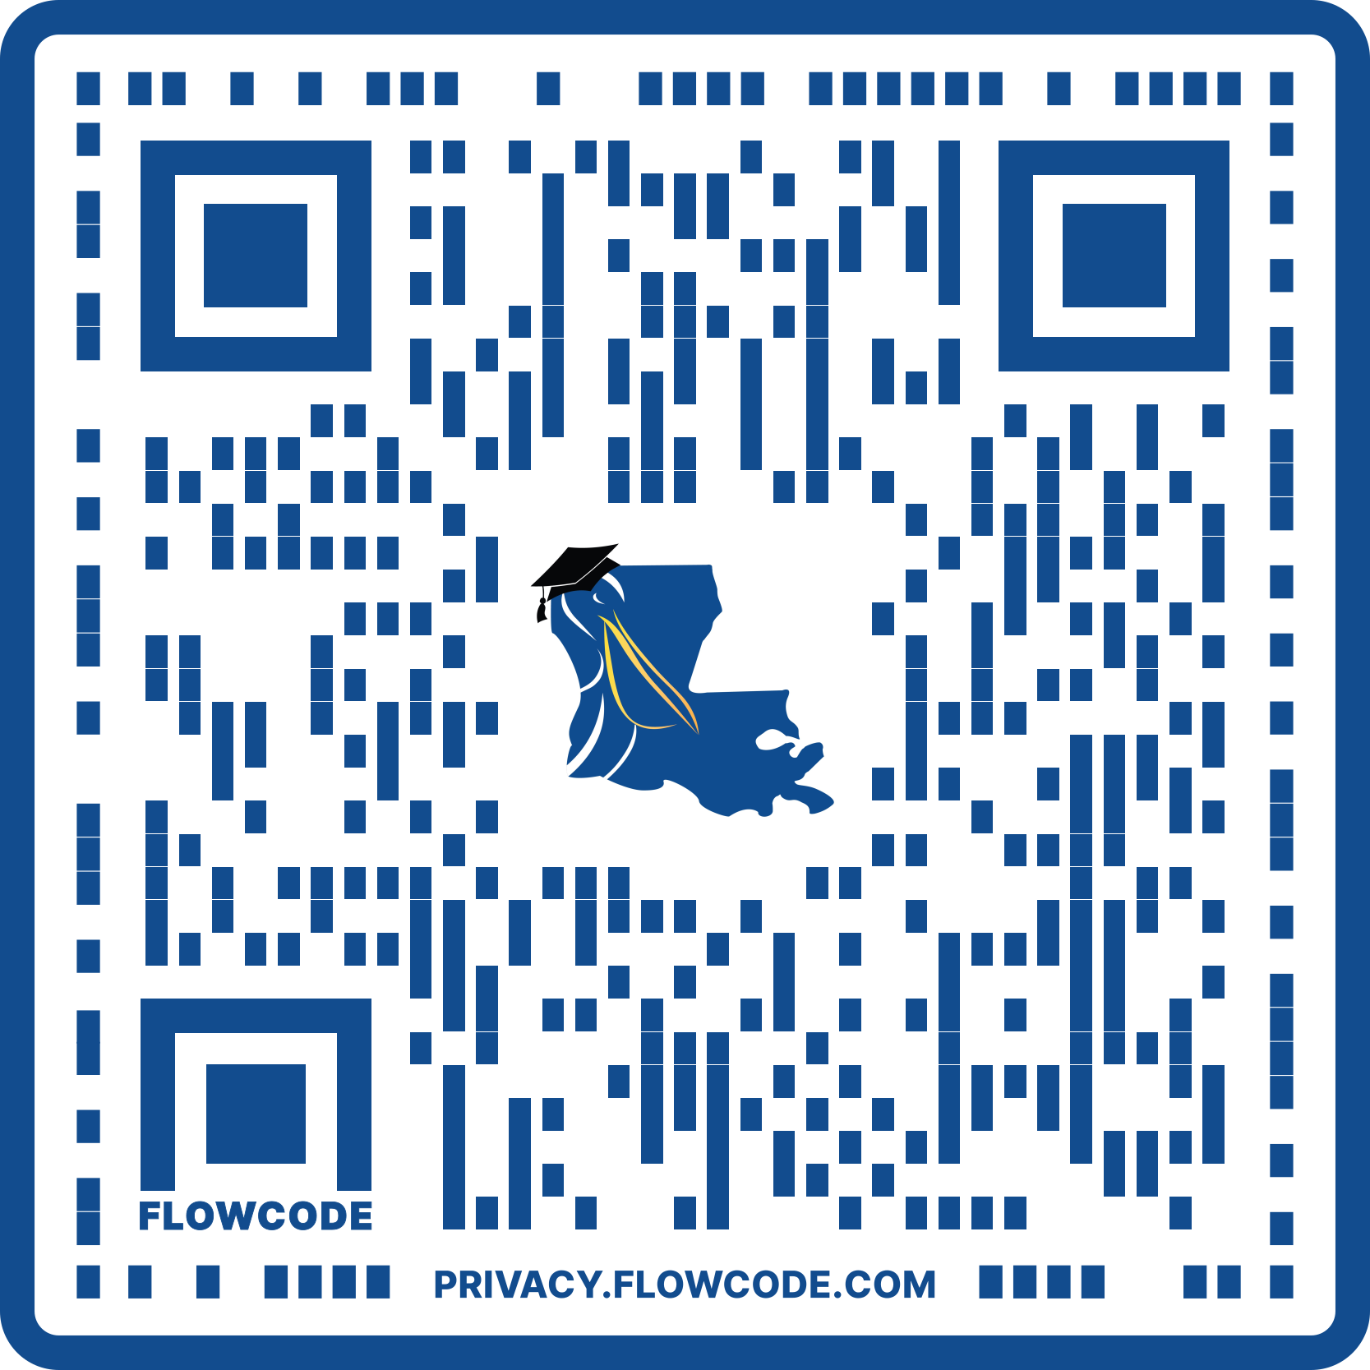
TOPS CORE CURRICULUM GPA
TOPS Core Curriculum Grade Point Average (GPA) is calculated on a 4.00-point scale, except the following designated courses that will use a 5.00-point scale:
Advanced Placement (AP) courses
International Baccalaureate (IB) courses
Gifted courses
Dual Enrollment courses
Honors courses
Articulated courses offered for college credit by the Louisiana School for the Math, Science, and the Arts.
The courses currently designated to be calculated on the 5.00-point scale can be viewed here.

Slide 42
TOPS CORE CURRICULUM GPA
The cumulative grade point average (GPA) for a TOPS award will be calculated using only those grades achieved in the core curriculum courses
If a student has completed more than 19 credits for courses that are included in the core curriculum, the GPA will be calculated by using the course in each core curriculum category for which the student received the highest grade
If a student is substituting two units for a one-unit category, the grades from the two units will be averaged together and substituted as one unit
“P” grades are not included in the TOPS Core GPA calculation
GPA cannot be rounded up

Slide 43
OPPORTUNITY AWARD ELIGIBILITY REQUIREMENTS
2.50 minimum TOPS Core Curriculum GPA
ACT score equal to the prior year’s state average, but never less than 20
SAT Score of 1030
CLT Score of 66
Completion of the TOPS Core Curriculum
TOPS general eligibility requirements

Slide 44
OPPORTUNITY AWARD BENEFITS
Provides a TOPS Award Amount or a portion of a TOPS Award Amount based on funds appropriated at a Louisiana public institution
Or a weighted average award amount at a LAICU private institution (contingent upon appropriations)
TOPS does not cover any fees (examples of fees may or may not include: academic excellence fees, energy surcharges, technology fees, books, room & board, parking fees, lab fees).
A TOPS award may be combined with other forms of financial aid up to the “Cost of Attendance” for the institution.

Slide 45
OPPORTUNITY AWARD BENEFITS
May be used to pursue:
Academic undergraduate degree
Vocational or technical certificate
Non-academic degree
Students who use their Opportunity Award to pursue a technical program will receive the same benefits and be held to the same retention requirements as a TOPS Tech Award recipient
The award may be used at eligible Louisiana cosmetology and proprietary schools.

Slide 46
OPPORTUNITY AWARD BENEFITS
May be received for a maximum of eight semesters or 12 quarters
Not available for summer terms except for students enrolled in a Qualified Summer Session and contingent upon sufficient appropriations

Slide 47
OPPORTUNITY AWARD BENEFITS
Any recipient who successfully completes a Bachelor’s degree in less than 8 semesters or 12 quarters of award benefits may receive any remaining terms of eligibility for graduate study.
The TOPS Award Payment for TOPS eligible students enrolled in a graduate/professional program is limited to the full tuition charged by a school for enrollment in the respective graduate program OR the maximum TOPS Award amount charged for undergraduate full-time enrollment at the highest cost public institution (LSU-HSC-NO), whichever is less.
Performance and Honors award recipients will receive their stipends.

Slide 48
PERFORMANCE AWARD ELIGIBILITY REQUIREMENTS
3.25 minimum TOPS Core Curriculum GPA
ACT score of 23
SAT score of 1130
CLT of 80
Completion of the TOPS Core Curriculum
TOPS general eligibility requirements

Slide 49
PERFORMANCE AWARD BENEFITS
Provides the same benefits as the Opportunity Award, plus
$400 annual stipend (contingent upon appropriations)

Slide 50
HONORS AWARD ELIGIBILITY REQUIREMENTS
3.50 minimum TOPS Core Curriculum GPA
ACT score of 27
SAT score of 1260
CLT score of 91
Completion of the TOPS Core Curriculum
TOPS general eligibility requirements

Slide 51
HONORS AWARD BENEFITS
Provides the same benefits as the Opportunity Award, plus
$800 annual stipend (contingent upon appropriations)

Slide 52
EXCELLENCE AWARD ELIGIBILITY REQUIREMENTS
3.50 minimum TOPS Core Curriculum GPA
ACT score of 31
SAT score of 1390
CLT score of 101
Completion of the TOPS Core Curriculum
TOPS general eligibility requirements

Slide 53
EXCELLENCE AWARD BENEFITS
Public Institutions - Provides an annual amount equal to tuition and fees or $12,000, whichever is less
LAICU Institutions – Equal to tuition and fees or $8,500, whichever is less

Slide 54
TOPS TECH AWARD ELIGIBILITY REQUIREMENTS
2.50 minimum TOPS or TOPS Tech Core Curriculum GPA
Minimum ACT score of 17
SAT score of 920
WorkKeys Silver Level Score
CLT score of 54
Completion of one of two TOPS Core Curricula
Opportunity, Performance, Honors, and Excellence Award curriculum
TOPS Tech Jumpstart Core Curriculum

Slide 55
TOPS TECH AWARD BENEFITS
May be used to pursue:
Associate's degree or other shorter-term training and education programs, including skill, occupational, vocational, technical, certificate, and academic, that the Workforce Investment Council (WIC) and the Board of Regents (BOR) determine are aligned to state workforce priorities.
Universal Transfer Pathways approved by the Board of Regents (BOR).
May receive for two years
Summer terms are covered for students attending a technical program (funding contingent upon appropriations). Summer attendance is not required.

Slide 56
TOPS ELIGIBLE INSTITUTIONS
PUBLIC

Slide 57
LOUISIANA STATE UNIVERSITY SYSTEM
Louisiana State University – Alexandria
Louisiana State University – Baton Rouge
Louisiana State University – Eunice
Louisiana State University – Shreveport
LSU Health Sciences Center – New Orleans
LSU Health Sciences Center – Shreveport

Slide 58

SOUTHERN UNIVERSITY SYSTEM
Southern University – Baton Rouge
Southern University – New Orleans
Southern University – Shreveport

Slide 59

UNIVERSITY OF LOUISIANA SYSTEM
Grambling State University
Louisiana Tech University
McNeese State University
Nicholls State University
Northwestern State University
Southeastern Louisiana University
University of Louisiana – Lafayette
University of Louisiana – Monroe
University of New Orleans

Slide 60

LOUISIANA COMMUNITY AND TECHNICAL COLLEGE SYSTEM
Louisiana Technical College – all campuses
Baton Rouge Community College
Bossier Parish Community College
Central Louisiana Technical Community College
Delgado Community College
L.E. Fletcher Technical Community College
Louisiana Delta Community College
Northshore Technical Community College
Northwest Louisiana Technical Community College
Nunez Community College
River Parishes Community College
South Louisiana Community College
SOWELA Technical Community College

Slide 61
TOPS ELIGIBLE INSTITUTIONS
PRIVATE

Slide 62

LOUISIANA ASSOCIATION OF INDEPENDENT COLLEGES AND UNIVERSITIES LAICU
Centenary College
Dillard University
Franciscan Missionaries of Our Lady University (Formerly Our Lady of the Lake College)
Louisiana Christian University
Loyola University New Orleans
New Orleans Baptist Theological Seminary
St. Joseph Seminary College
Tulane University
University of Holy Cross
Xavier University

Slide 63
TOPS APPLICATION
There are two options for applying for a TOPS Scholarship:
FAFSA® (Free Application for Federal Student Aid) –www.studentaid.gov
The FAFSA® allows you to apply for TOPS, other state aid, and all federal aid.
OR
TOPS Online Application – www.mylosfa.la.gov
Use this application to apply for TOPS only.
Do not complete if you have completed the FAFSA®.

Slide 64
TOPS PROCESSING CYCLE
Students apply for TOPS
FAFSA® data is electronically sent to LOSFA by the U.S. Department of Education.
TOPS Online Applications are entered directly on the LOSFA website.
LOSFA downloads ACT and SAT scores for students who have included the ACT code 1595 on their ACT registration or LOSFA receives SAT scores for students who have included the SAT code of 9019 on their SAT registration.

Slide 65
TOPS PROCESSING CYCLE
Processing cannot begin until we can match your FAFSA® or TOPS Online Application data and ACT data.
Must have received all TOPS home study documentation.
LOSFA runs the TOPS Eligibility Program each Monday and Thursday night.

Slide 66
TOPS PROCESSING CYCLE
TOPS award notifications are emailed each Friday.
Award notifications are emailed to the email address the student provided on the FAFSA® or TOPS Online Application.
The award letter includes the student’s Rights and Responsibilities.
Students can check their status on the Student Hub.
Students who have not received notification of their TOPS award eligibility by mid-July should contact LOSFA.

Slide 67
TOPS PROCESSING CYCLE
A Master Roster of TOPS eligible students is available for Louisiana institutions to download from LOSFA each Monday.
Institutions electronically bill LOSFA for the TOPS Awards of eligible students who are enrolled full-time through the fifteenth class day of the semester or ninth day of the quarter.

Slide 68

AWARD ACCEPTANCE
Must enter an eligible institution as a full-time student by the fall semester following the first anniversary of high school graduation

Slide 69

AWARD ACCEPTANCE: MILITARY SERVICE
A TOPS eligible student who joins the Armed Forces on active duty within one year of high school graduation must enter an eligible institution by the semester immediately following the one-year anniversary of separation from active duty.
Must have received an honorable discharge or a general discharge under honorable conditions
Must apply within one year of separation from active duty

Slide 70

NATIONAL GUARD TOPS RECIPIENTS
TOPS recipients serving in the Louisiana National Guard shall receive:
The National Guard tuition exemption in lieu of the TOPS tuition amount
$300 per semester for books and supplies
Plus TOPS stipend
Performance Award: $400 per semester
Honors Award: $800 per semester
Excellence Award:

Slide 71
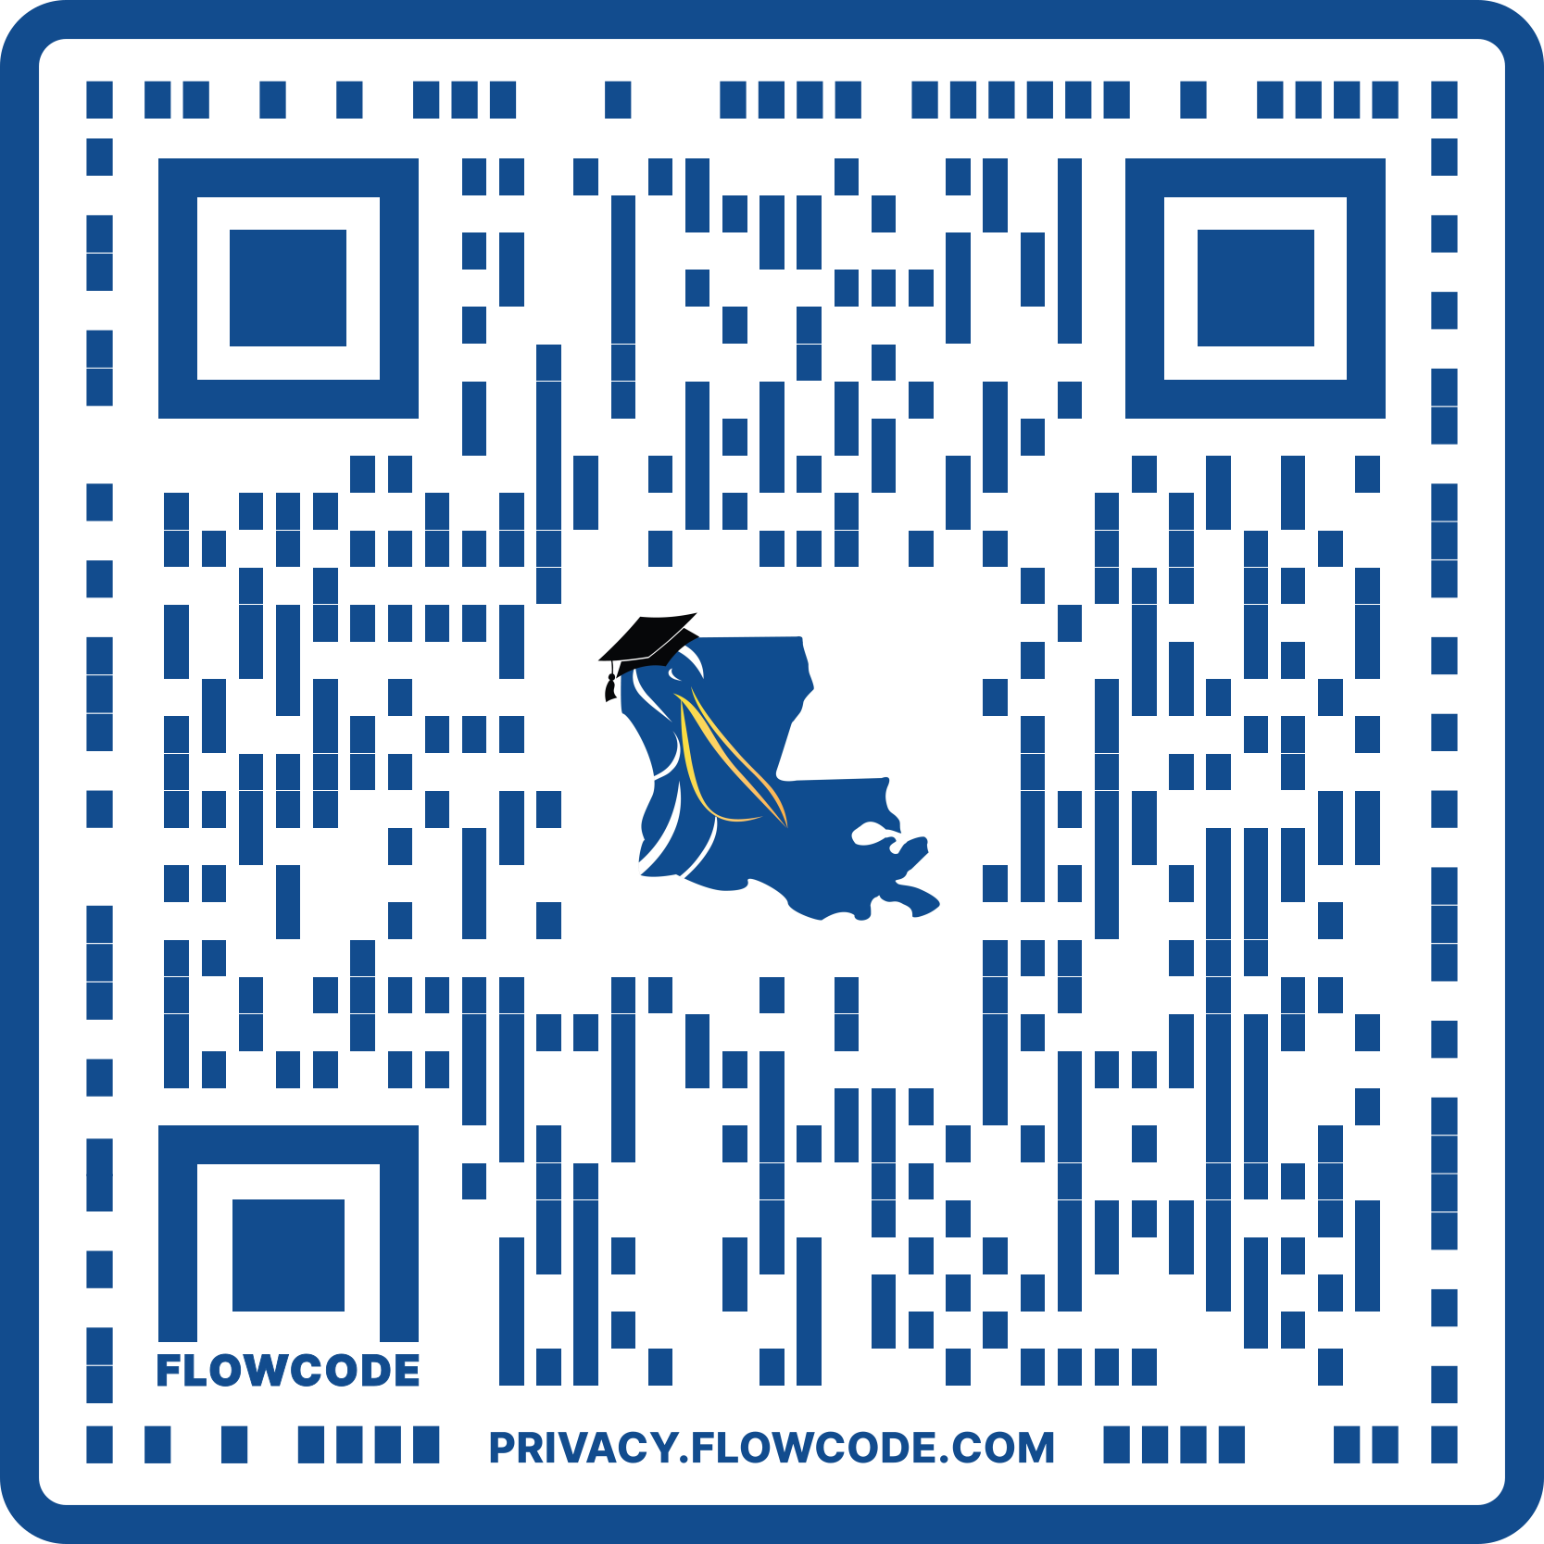
NATIONAL GUARD PATRIOT SCHOLARSHIP
National Guard Patriot Scholarship:
The National Guard Patriot Scholarship provides scholarships to Louisiana National Guard members who are enrolled in a Louisiana public postsecondary institution and who are eligible for the Louisiana National Guard tuition waiver.
This program provides for the payment of mandatory fees charged to the student by the institution as funds are appropriated.

Slide 72
TOPS RETENTION

Slide 73
TOPS RETENTION REQUIREMENTS
Should apply annually by July 1st by completing the Renewal FAFSA®
Must be continuously enrolled on a full-time basis during the academic year
A student is considered full-time for the semester if they are carrying full-time hours through the 15th class day of the semester or 9th day of the quarter.

Slide 74
TOPS RETENTION REQUIREMENTS: CREDIT HOURS
Must earn 24 credit hours each academic year
Failure to earn 24 hours will result in permanent award cancellation.
Hours earned in advanced placement may not be used.
Hours earned during any intersession held between the beginning of the fall semester and the beginning of the following fall semester can be used.
Hours earned in required remedial courses may be used.
“Earned Hours” are hours successfully completed with a passing grade (“D” or better).

Slide 75
TOPS RETENTION REQUIREMENTS: ACADEMIC YEAR (COLLEGE)
Begins with the fall term of the award year and concludes immediately before the next fall term commences.
All intersessions and summer sessions are included.

Slide 76
TOPS RETENTION REQUIREMENTS: TOPS AND SUMMER SESSIONS
The TOPS Opportunity, Performance, Honors, and Excellence Awards will not pay for college summer sessions except when:
You have earned at least 60 hours of college credit.
The summer session is required in your degree program for graduation, and you enrolled for at least the minimum number of hours required for the degree program.
You can complete your program’s graduation requirements in the summer session.
The course(s) taken during the summer session is required for graduation in the program in which you are enrolled and is only offered during the summer session.
The summer session is conducted for a nonacademic program in which you are enrolled.

Slide 77
TOPS RETENTION REQUIREMENTS: SUMMER SESSIONS
Students who do not meet the TOPS summer session criteria may always attend a summer session at their own expense.
An award made for summer school expends one semester or term of TOPS eligibility.
Funding is contingent upon appropriation.

Slide 78
TOPS RETENTION REQUIREMENTS: CREDIT HOURS
Exceptions to the continuous enrollment or 24-hour requirement may be granted by LOSFA for reasons beyond the student’s control
Parental Leave
Physical Rehabilitation Program
Substance Abuse Rehabilitation Program
Temporary Disability – Self
Care of Immediate Family Member With a Temporary Disability
Permanent Disability
Exceptional Educational Opportunity
Religious Commitment
Death of an Immediate Family Member
Military Service – Student
Military Service - Spouse
Transfer to a Selective Enrollment Program
Unavailability of Courses
Natural Disaster
Exceptional Circumstances
Must request within 6 months of award cancellation. If on active duty with the armed forces, must request within 6 months from release of active duty.

Slide 79
TOPS RETENTION REQUIREMENTS: GPA
AT THE END OF EACH ACADEMIC YEAR, THE FOLLOWING CUMULATIVE COLLEGE GPA MUST BE MAINTAINED

Slide 80
TOPS RETENTION REQUIREMENTS: OPPORTUNTY AWARD
Opportunity Award
2.30 GPA (24-47 hours)
2.50 GPA (48+ hours)
Opportunity award recipients who fail to maintain the retention GPA will be suspended.

Slide 81
TOPS RETENTION REQUIREMENTS: PERFORMANCE, HONORS, & EXCELLENCE AWARDS
3.00 GPA
Performance or Honors award recipients who fail to maintain a 3.00 cumulative GPA will revert to the Opportunity award (Students will be funded only if they meet the Opportunity Award retention requirements)
Once the recipient reverts to the Opportunity award, the Performance or Honors award may not be reinstated
Excellence award recipients who fail to maintain a 3.00 cumulative GPA will revert to the Opportunity award

Slide 82
TOPS RETENTION REQUIREMENTS: TECH AWARD
Tech Award
2.50 GPA

Slide 83
TOPS RETENTION REQUIREMENTS: STEADY ACADEMIC PROGRESS
“Steady Academic Progress” is defined as a 2.00 cumulative GPA.
Steady Academic Progress must be maintained at the end of any semester or quarter.
NOTE: You must have a 2.00 cumulative GPA on ALL hours at the end of each semester/quarter/term. To continue receive your award from one year to the next, you must have the continuation GPA required for your award level.
Failure to maintain Steady Academic Progress will result in award suspension.

Slide 84
TOPS RETENTION REQUIREMENTS: AWARD REINSTATEMENT
Students whose awards are suspended for GPA or Steady Academic Progress may be reinstated upon attainment of the required continuation GPA.
Period of ineligibility may not persist for more than two years for TOPS Opportunity, Performance and Honors Awards, one year for TOPS Tech Award.

Slide 85
APPLYING FOR TOPS
TOPS ONLINE APPLICATION OR THE FREE APPLICATION FOR FEDERAL STUDENT AID (FAFSA®)

Slide 86
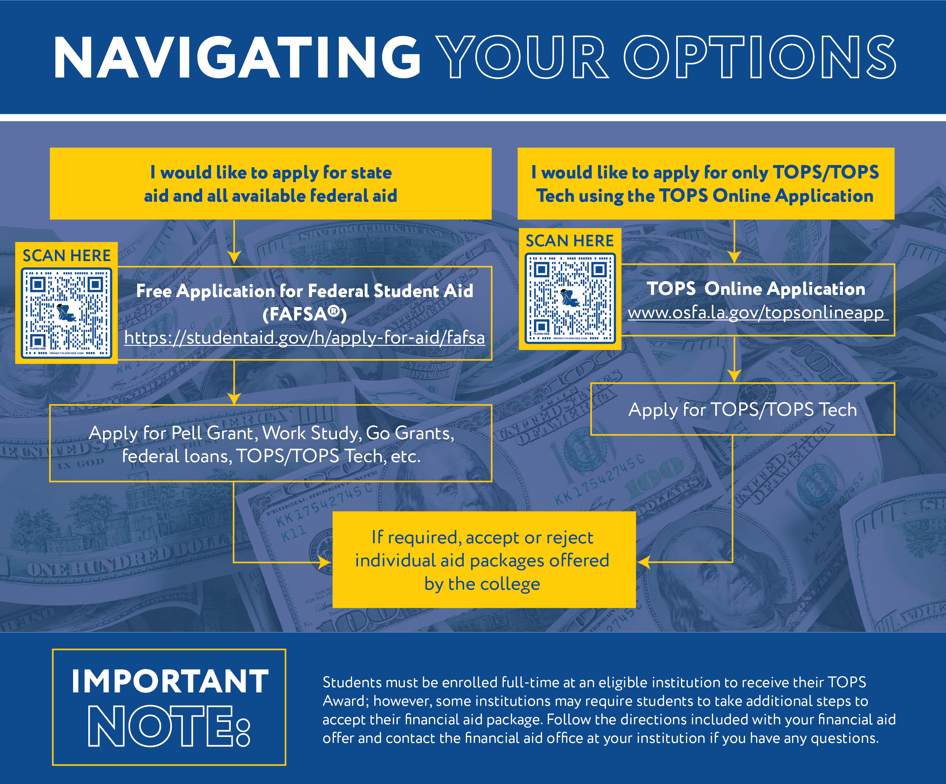
NAVIGATING YOUR OPTIONS: APPLICATIONS
The Free Application for Federal Student Aid (FAFSA®) is no longer a graduation requirement for public school students.
Graduating seniors must complete either a FAFSA® or TOPS Online Application to be considered for TOPS eligibility.
Students who qualify for federal aid should complete the FAFSA® each year to apply for federal aid while in college.
The 2026-2027 FAFSA® is scheduled to be released on October 1, 2025.

Slide 87
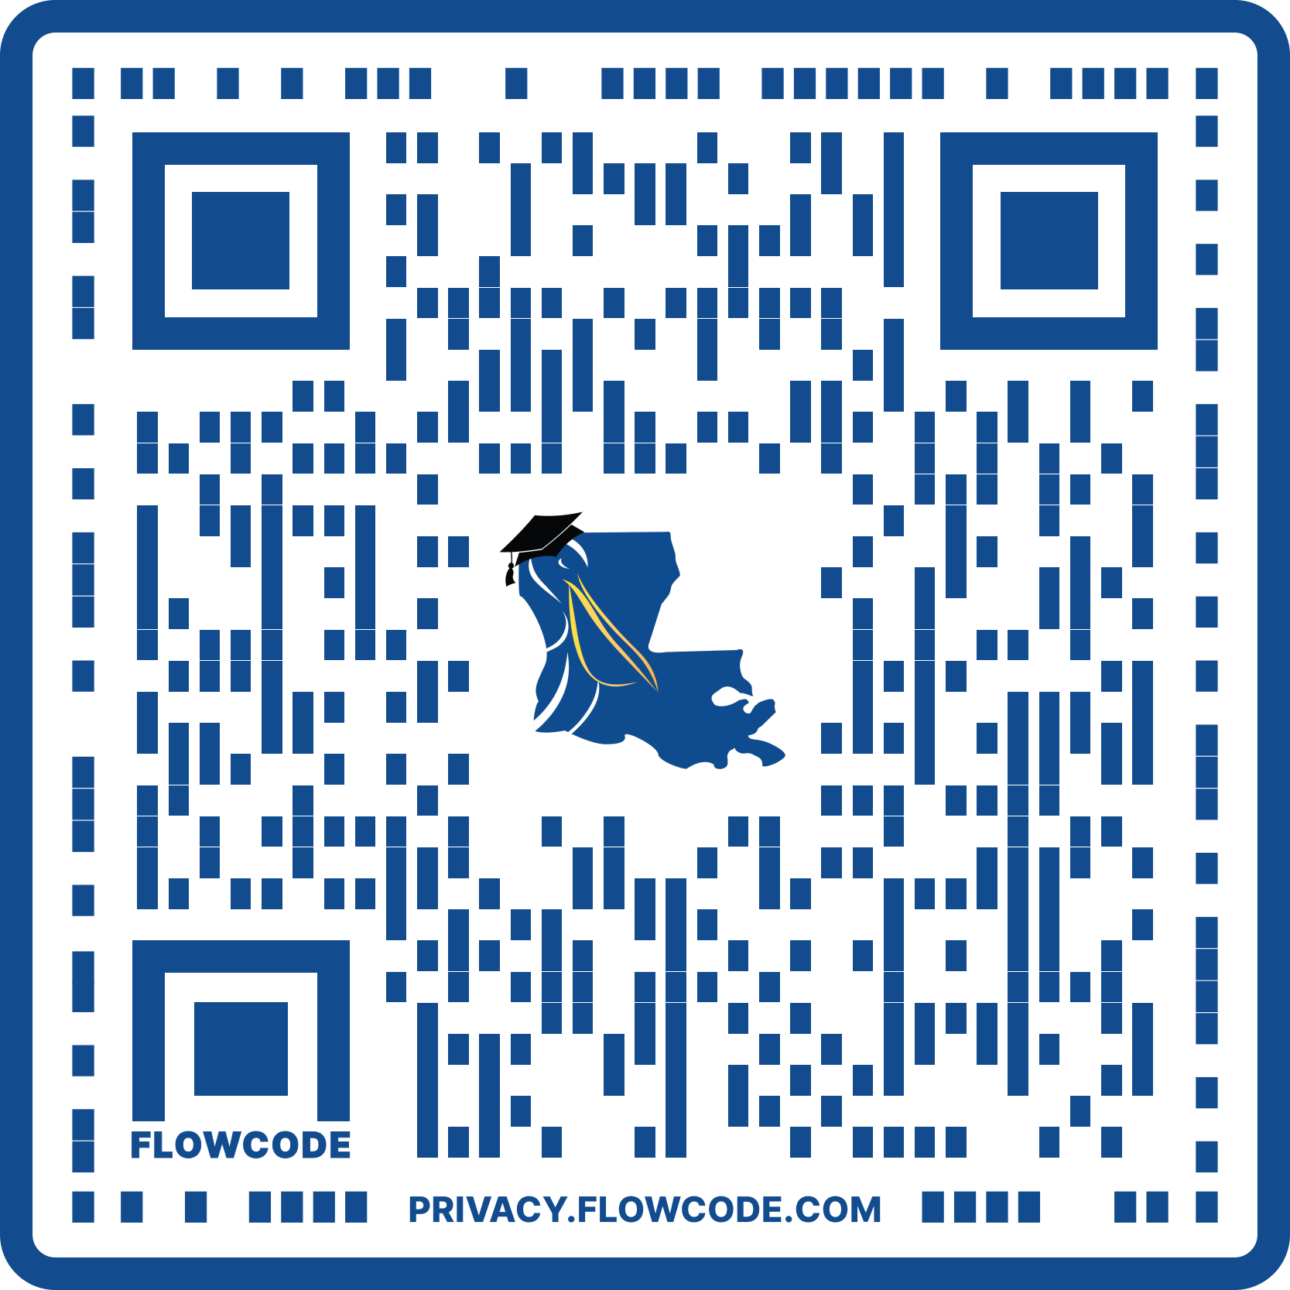
TOPS ONLINE APPLICATION
The TOPS Online Application is available to students who can demonstrate they do not qualify for federal financial aid.

Slide 88
STUDENT: DEMOGRAPHICS
Social Security Number
Birthdate
Full Name
High School Graduation Date
Address – Street, City, State, Zip Code
Student’s Phone Number and Type (Home or Mobile)
Student and Parent Email Addresses
Louisiana Residency Questions
Citizenship

Slide 89
STUDENT: DEMOGRAPHICS
Where student graduated from: high school, home study
Enrolled Full-time Out of State
Convicted of Crime Other Than Misdemeanor
U.S. Armed Forces Service Question
Certification and Submission of Application

Slide 90

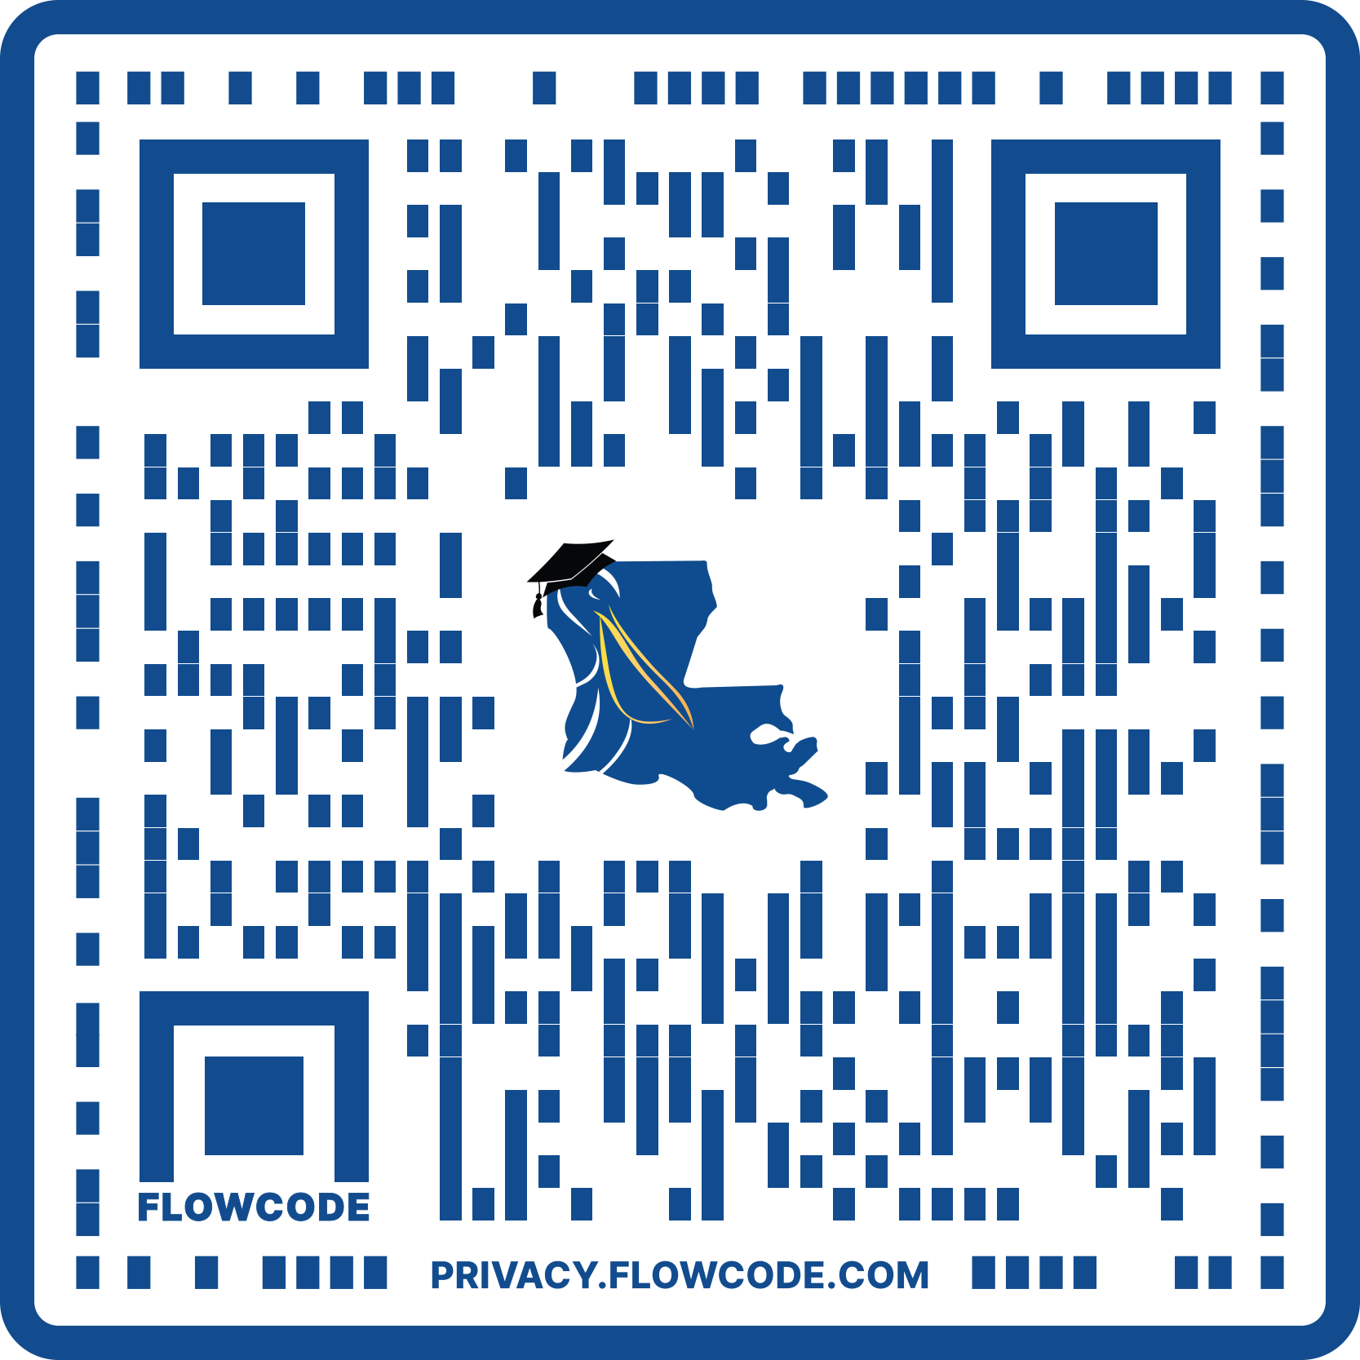
FAFSA®
The Free Application for Federal Student Aid (FAFSA®) is the application for both federal and state aid programs.
Be sure to fill out the FAFSA® even if you don’t think you’ll qualify for need based aid.
The FAFSA® is the only application needed for the TOPS scholarship.
Louisiana’s priority deadline is February 1.
You should never be asked to pay to fill out the FAFSA®. It is a FREE application.

Slide 91
FAFSA®
The only financial aid directly determined from the FAFSA® data is eligibility for the federal Pell Grant.
The primary purpose of the FAFSA® is to establish the student’s Student Aid Index (SAI).
The SAI is used by the institution in a process called packaging to determine your eligibility for campus-based aid programs including FSEOG, GO Grant, federal work study, and William D. Ford Direct Loans.

Slide 92
FAFSA® FILING METHODS
FAFSA® On the Web: www.studentaid.gov
Faster processing
“Skip logic” – students are only asked questions that apply to them
Immediate SAI estimate
Online receipt verification
Live online help

Slide 93
FAFSA® SUBMISSION DATES
When a Student Is Attending College (School Year) | When a Student Can Submit a FAFSA® | Which Year's Income Information Is Required?
July 1, 2026 – June 30, 2027 | October 1, 2025 – June 30, 2027 | 2024
July 1, 2027 – June 30, 2028 | October 1, 2026 – June 30, 2028 | 2025
July 1, 2028 – June 30, 2029 | October 1, 2027 – June 30, 2029 | 2026
July 1, 2029 – June 30, 2030 | October 1, 2028 – June 30, 2030 | 2027

Slide 94
STUDENT: DEMOGRAPHICS
Social Security Number
State of Legal Residence
Citizenship status
Interest in Student Loans
Student Finances
Records the student’s income, assets, and types of federal benefits received

Slide 95
STUDENT: PERSONAL CIRCUMSTANCES
This section determines your dependency status
The SAI of a dependent student is based on both your financial information and your parents’ financial information
The SAI of an independent student is based on your (and your spouse’s) financial information

Slide 96
STUDENT: PERSONAL CIRCUMSTANCES
To be considered an independent student, you must be able to answer yes to one of the following questions:
Were you born before January 1, 2003?
As of today, are you married? (Answer “No” if you are separated but not divorced).
At the beginning of the 2026-2027 school year, will you be working on a master’s or doctorate degree?
Are you currently serving on active duty in the U.S. Armed Forces for purposes other than training?
Are you a veteran of the U.S. Armed Forces?

Slide 97
STUDENT: PERSONAL CIRCUMSTANCES
To be considered an independent student, you must be able to answer yes to one of the following questions:
Do you have children or other people (excluding your spouse) who live with you and receive more than half of their support from you now and between July 1, 2026, and June 30, 2027?
At any time since you turned age 13, were you an orphan?
At any time since you turned age 13, were you a ward of the court?
Are you or were you a legally emancipated minor, as determined by a court in your state of residence?
Are you or were you in a legal guardianship with someone other than your parent or stepparent, as determined by a court in your state of residence?

Slide 98
STUDENT: PERSONAL CIRCUMSTANCES
To be considered an independent student, you must be able to answer yes to one of the following questions:
At any time on or after July 1, 2025, were you unaccompanied and either (1) homeless or (2) self-supporting and at risk of being homeless?*
*You’ll be considered provisionally independent and will be allowed to fill out the FAFSA® form as an independent student if you indicate that you are unaccompanied and homeless or at risk of being homeless on the FAFSA® form for the first time and you don’t have a determination from an individual at an eligible agency. An individual at an eligible agency includes one of the following:
your high school or district homeless liaison or designee
the director or designee of an emergency or transitional shelter, street outreach program, homeless youth drop-in center, or other program serving those experiencing homelessness
the director or designee of a project supported by a federal TRIO program or a Gaining Early Awareness and Readiness for Undergraduate Programs (GEAR UP) grant
a financial aid administrator

Slide 99
STUDENT: UNUSUAL CIRCUMSTANCES
In situations such as the ones below, a student may be able to submit their FAFSA® form without parent information despite being considered a dependent student:
The student or the student’s parent are incarcerated;
Student left home due to an abusive or threatening environment;
Student has been abandoned by or estranged from their parents and has not been adopted;
Student has been granted refugee or asylee status and are separated from their parents, or their parents are displaced in a foreign country;
Student is a victim of human trafficking;
Student is otherwise unable to contact or locate their parents and has not been adopted.

Slide 100
SPECIAL SITUATIONS
Beginning with the 2024-25 award year, otherwise dependent students who indicate that they have unusual circumstances that prevent them from providing parent data will no longer receive a rejected application.
These students will have their application processed with a provisional independent status.
This will generate output documents with a provisional SAI and an estimate of federal student aid eligibility.
Aid administrators will need to make a final determination on whether these students should receive a dependency override.
Students should make an appointment with a financial aid counselor at the institution they plan to attend for guidance.

Slide 101
SELECT COLLEGES
May select up to 20 institutions to receive FAFSA® data when filing online
Make sure to list a Louisiana school first for TOPS purposes.

Slide 102
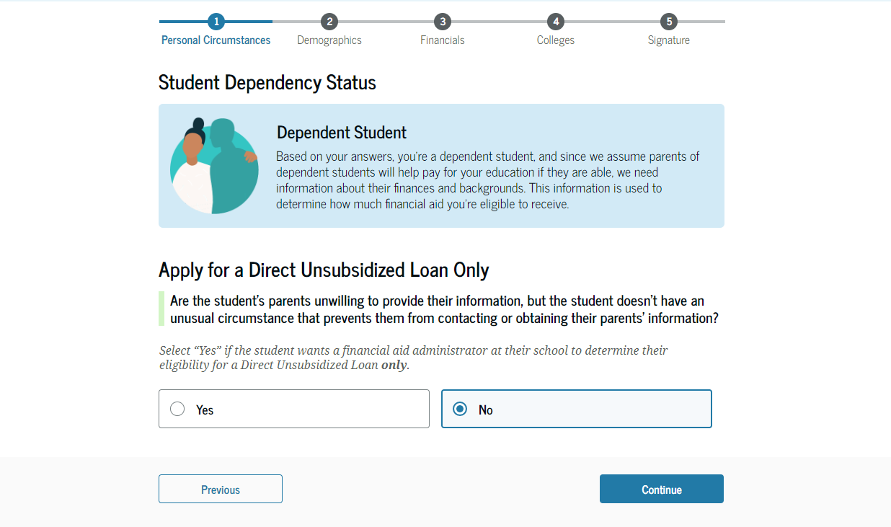
DIRECT UNUSUBSIDIZED LOAN ONLY
The student is asked if they want a financial aid administrator to determine their eligibility for a Direct Unsubsidized Loan only and not for other forms of financial aid.
Direct Unsubsidized Loans do not require students to demonstrate financial need. Students are responsible for paying the interest that accrues during all periods.
This is an option if the student’s parents are unwilling to provide information. The student selects "No."

Slide 103
PARENTAL INFORMATION
Skip if you are an independent student.
Whose information do you use?
“Contributor” is a new term that first appeared on the 2024–25 FAFSA® form.
A “contributor” refers to anyone (you, your spouse, your biological or adoptive parent, or your parent’s spouse) who’s asked to provide their information, consent and approval to have their federal tax information transferred automatically from the IRS into the FAFSA® form (more on that later), and signature on the FAFSA® form.
Note: Unless they’ve legally adopted you, your grandparents, foster parents, legal guardians, siblings, and aunts and uncles aren’t considered contributors—even if they help provide for or raise you.

Slide 104
INVITING CONTRIBUTORS TO THE FAFSA® FORM
Whoever starts the FAFSA® first will need to identify the “contributors.”
Students completing a 2026–27 FAFSA® form will be able to invite a parent as a contributor simply by entering their email—instead of asking students for a contributor’s personally identifiable information—which will generate a unique, non-case sensitive code.
The code will be sent to the parent by email. They will be directed to accept the invite by entering the code on an “Accept an Invite” page that can be accessed by email or StudentAid.gov once they are logged in.
If a contributor begins a FAFSA® on behalf of a student, they will use the existing process to invite the student to the form. In that case, the student must have a StudentAid.gov account and will be linked immediately to the application upon being invited.

Slide 105
PARENTAL: DEMOGRAPHICS
You might need the following information:
Tax returns
Records of child support received
Current balances of cash, savings, and checking accounts
Net worth of investments, businesses, and farms
The number of family members in college is no longer a factor in the needs analysis.
Parent contributor’s residency
Parent contributor’s email address
The definition of family size has changed to align with the number of individuals reported as dependents on the applicant’s (if independent) or applicant’s parents’ (if dependent) U.S. tax return.
Applicants may update family size if it changes after filing the tax return.

Slide 106
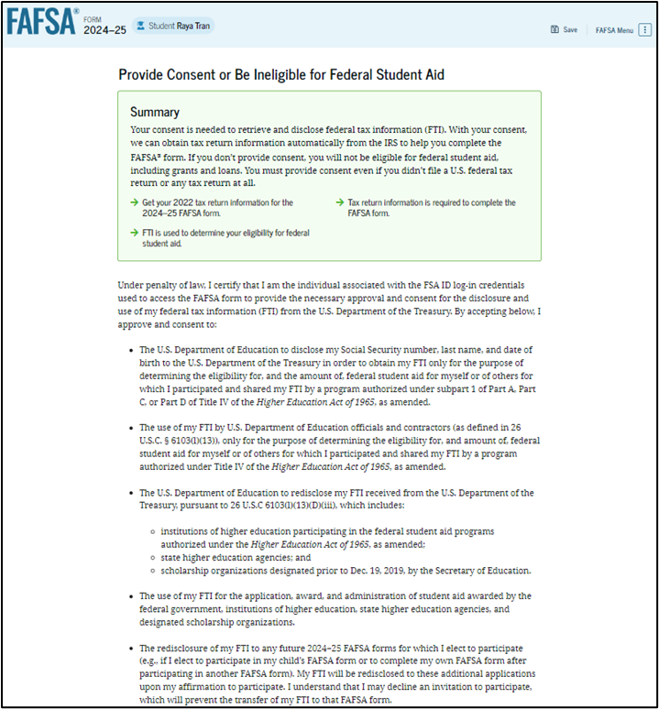
FEDERAL TAX INFORMATION (FTI)
All contributors must consent to the use of their Federal Tax Information (FTI) on the FAFSA®.
This allows FSA to obtain your federal tax information automatically from the IRS to help you complete the FAFSA® form.
An applicant or contributor can enter income and tax data manually on the FAFSA®.
The student will not be eligible for federal student aid until all required contributors provide consent.

Slide 107
STUDENTAID.GOV ACCOUNT (FSA ID)
A StudentAid.gov account (FSA ID) allows students and parents to identify themselves electronically to access Federal Student Aid websites.
FSA ID two-step verification will be required for everyone.
Logging into a FAFSA® using student demographic information will no longer be possible.

Slide 108
DO PARENTS NEED AN FSA ID?
If you’re a dependent student, then your parent will need an FSA ID to sign your Free Application for Federal Student Aid (FAFSA®) form electronically.
IMPORTANT
You and your parent must have different FSA IDs.
You must create your own FSA ID—it’s your electronic signature, and you need to own it.
Your parent must create his or her own FSA ID.
You and your parent should each use your own email address and cell phone number when creating an FSA ID (you can’t use/share the same email address and cell phone number).

Slide 109
SIGNATURE PAGE
For a dependent student, both the student and the parent must sign.
FAFSA® on the web may be signed using the FSA ID.
The parent and student must have separate FSA IDs.
Parents may use the same FSA ID for all their children.

Slide 110
RESOURCES

Slide 111


TOPS RESOURCES
SCAN HERE
TO ACCESS TOPS Q&As
Notes:
Completing the FAFSA® | Louisiana Office of Student Financial Assistance
TOPS Guide.pdf

Slide 112
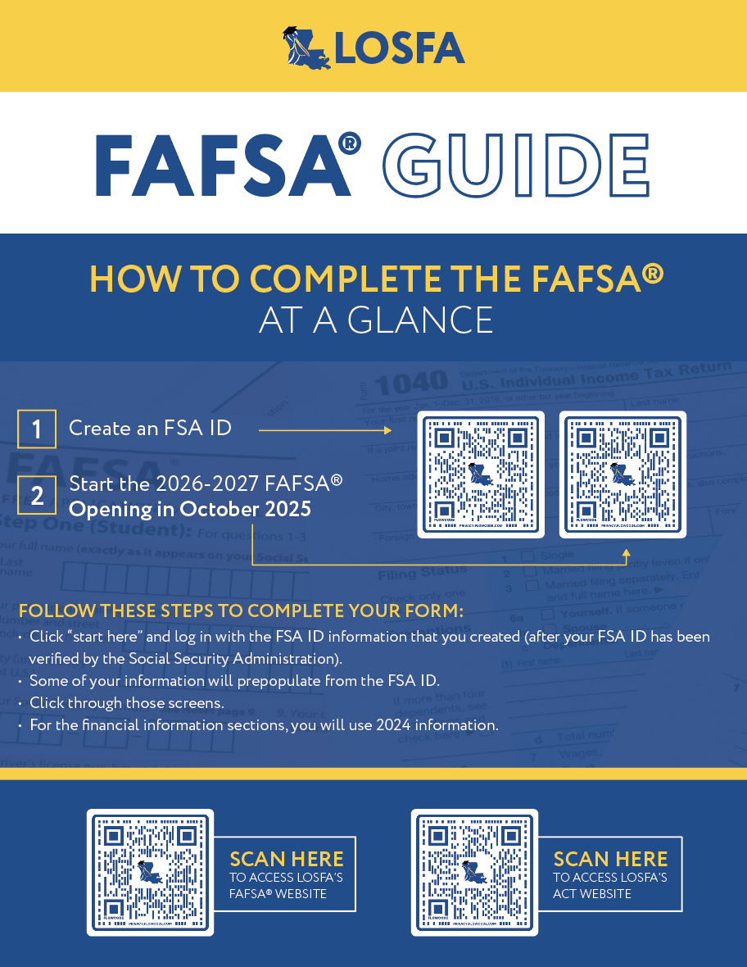
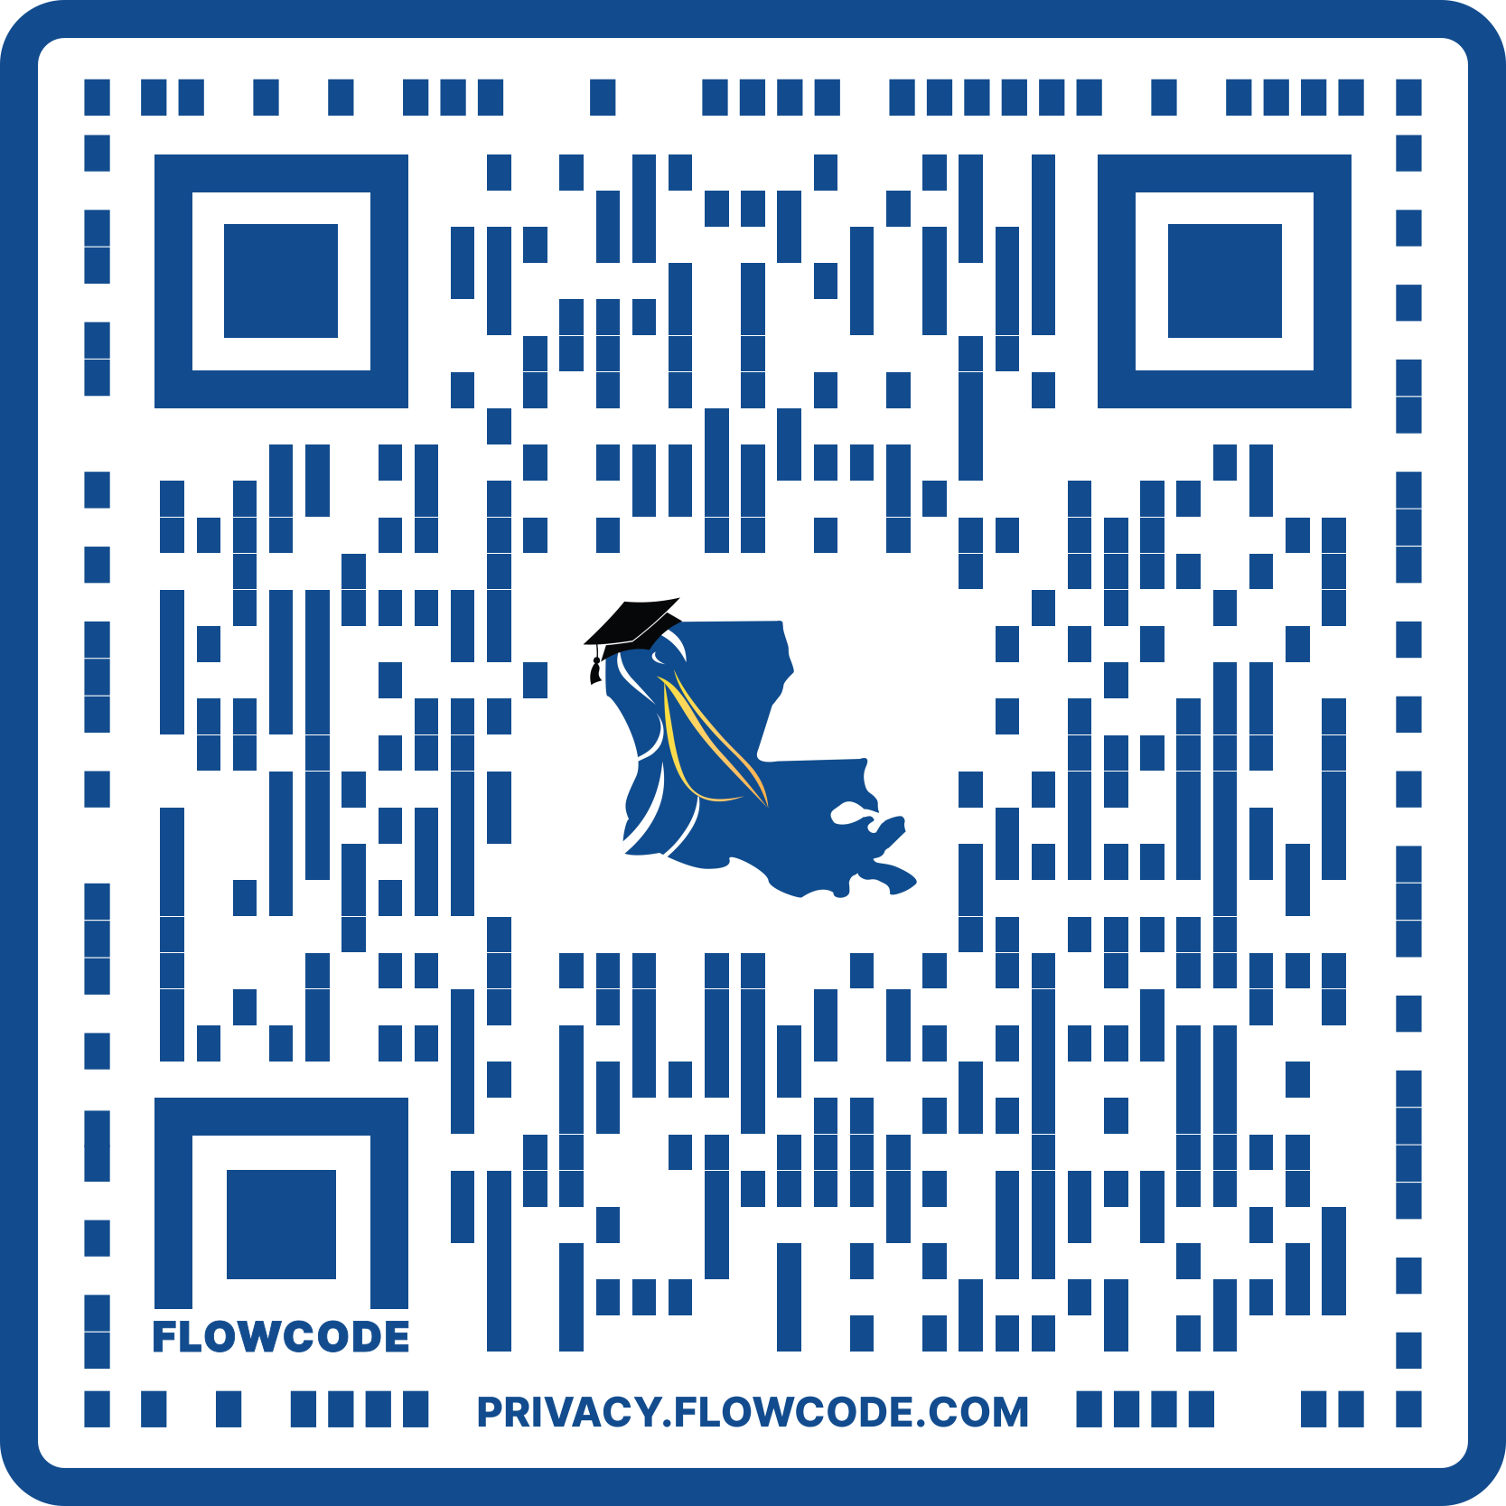
FAFSA® RESOURCES
SCAN HERE
TO ACCESS LOSFA’S FAFSA® WEBSITE
Notes:
Completing the FAFSA® | Louisiana Office of Student Financial Assistance

Slide 113
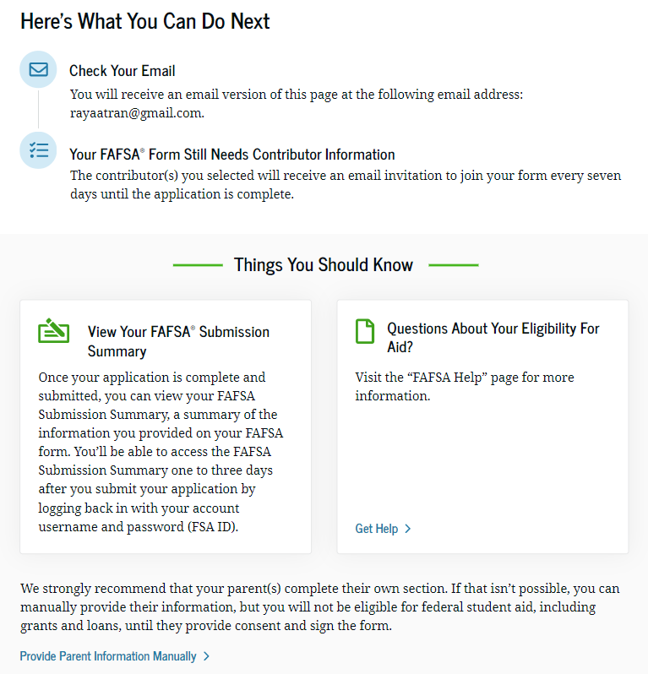
FAFSA® SUBMISSION SUMMARY
The FAFSA® Submission Summary provides you with:
Student Aid Index (SAI)
Pell Grant Eligibility
Listing of institutions which will receive your data
A financial aid history
A listing of your responses to the FAFSA®
Corrections may be made:
Online at www.studentaid.gov
By phone at (800) 433-3243

Slide 114




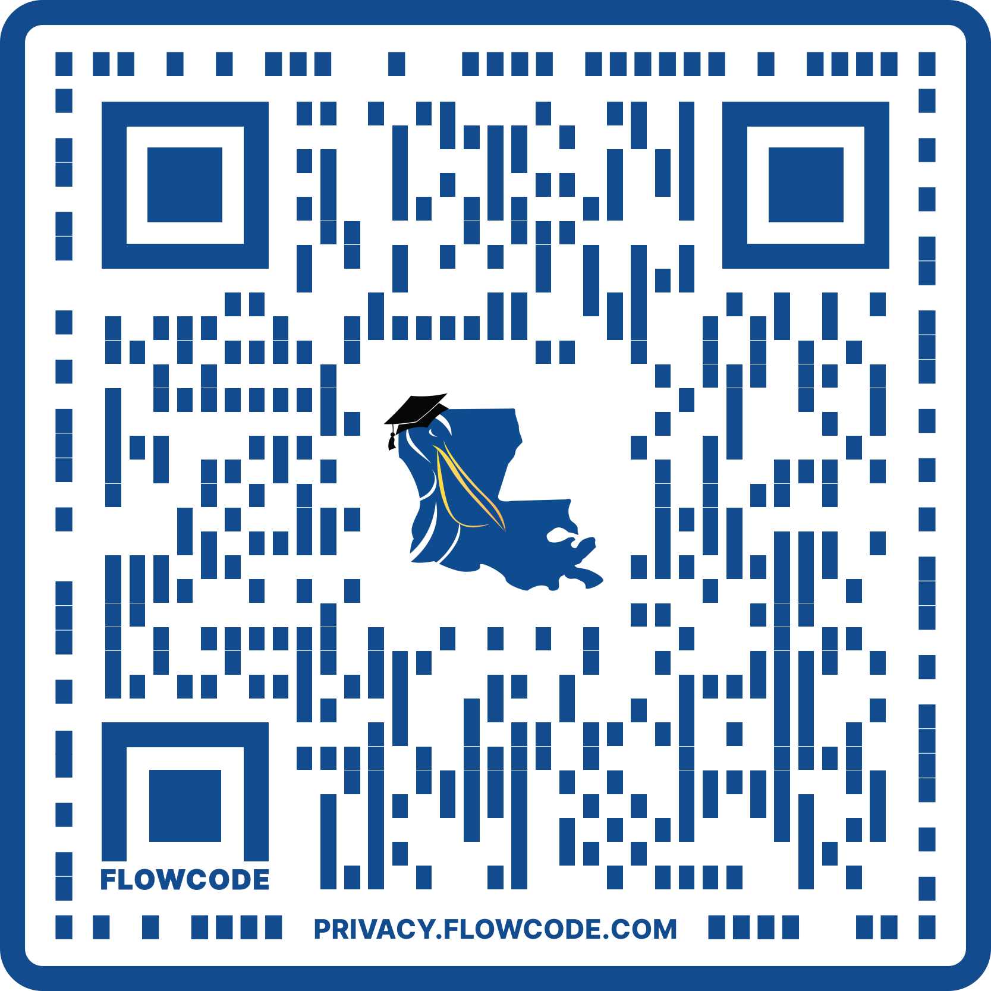
COMPREHENSIVE ADVISING
STATEWIDE COMPREHENSIVE COLLEGE ACCESS ADVISING SERVICES
We can help with:
Identifying how to prepare and pay for college through scholarships, grants, and financial aid.
Matching your interests, skills, and passions with a career and connecting you to employers through career exploration, job shadowing, internships, and job placement opportunities.
Any Student. Any Age.
Anywhere in Louisiana.
Discovering pathways to earn your credential or degree, finding the school that's the best fit for you, and connecting you with available support and wrap-around services.
No matter where you are on the college access journey, LOSFA's Comprehensive Advising Officers can assist you.
Scan here
for additional information

Slide 115

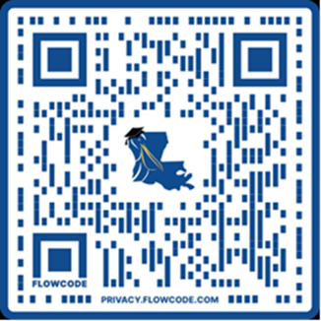
GET CONNECTED WITH STUDENT NETWORK GROUPS
VIRTUAL NETWORK GROUPS:
Nursing
Accounting/Finance
Engineering
Information Technology/ Computer Information Systems
Behavioral Health Profession
Education
Postsecondary Transition
Multidisciplinary-For all
Providing Louisiana’s Students the Opportunity to:
1
Network with other students throughout Louisiana.
2
Discover resources and opportunities for successful
degree completion, internships, and job placement.
3
Connect with professionals and/or employers from
their respective fields.
Scan here
for additional information

Slide 116






CONNECT WITH LOSFA
@losfa
@losfa
@losfa1000
@losfa001

Slide 117


CONTACT LOSFA
ON THE WEB
ASK
LEX
www.mylosfa.la.gov
custserv@la.gov
GeauxFAFSA@la.gov
VIRTUAL OFFICE HOURS
LEX is LOSFA’s virtual response assistant
LEX is available on LOSFA’s Website at www.mylosfa.la.gov
Available 24/7 to answer questions about LOSFA Programs
9:00 a.m. – 3:00 p.m.
Monday – Friday

Slide 118
QUESTIONS?
custserv@la.gov

